Slide 1

Group Chat Behaviour Analysis
Under
The
Guidance
Of
Dr. Pooja Jain
Using
Natural
Language
Processing
Collaborators
BT19CSE121 Aniket Ransing
BT19CSE128 Gaurav Bhandarkar

Slide 2


OUR PROJECT
Cleans The Group Chat Text To Extract Useful Tokens and Then Passes Those Tokens To Our Deep Learning Model
😜🤔🥱

Slide 3
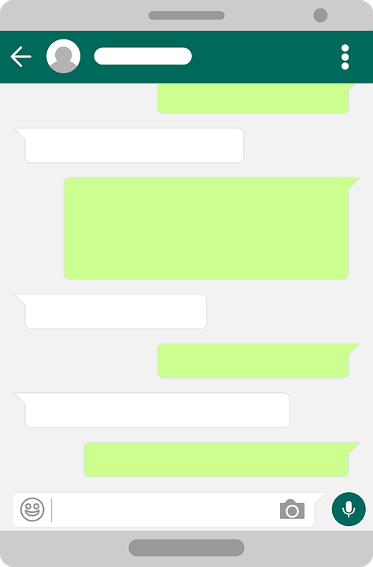
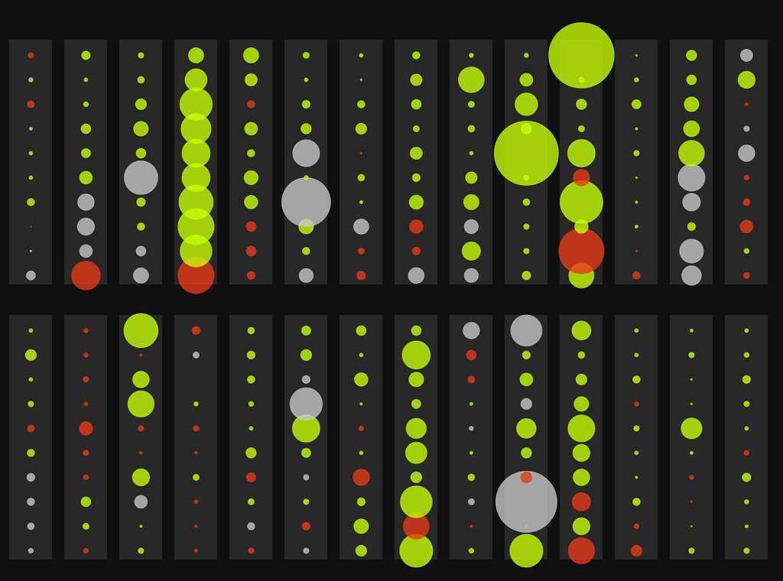
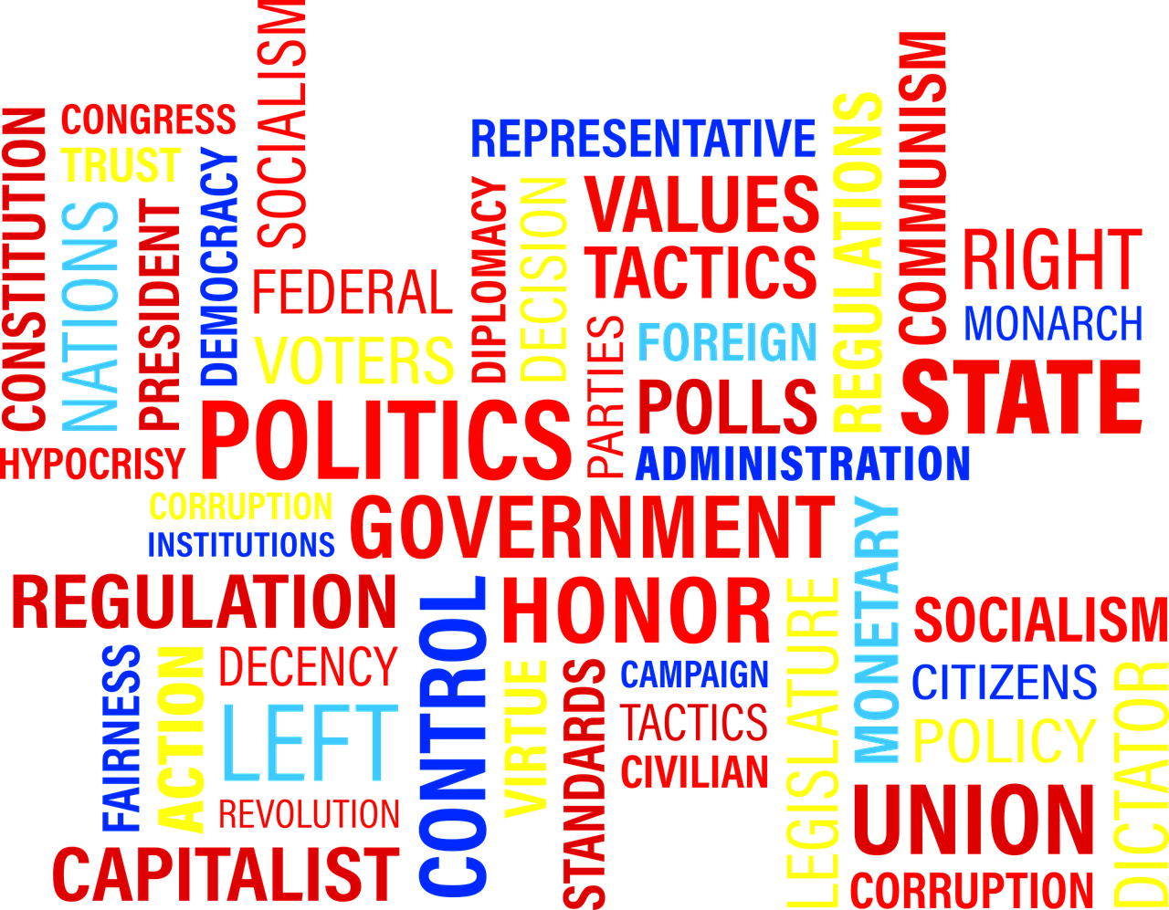
Dataset of
Text Chat
NLP Model
Word Cloud

Slide 4
Data Analysis
Dataset
Processed Data
Assessing Results
Final Output
Pre-processing The Data
Data Conversion

Slide 5
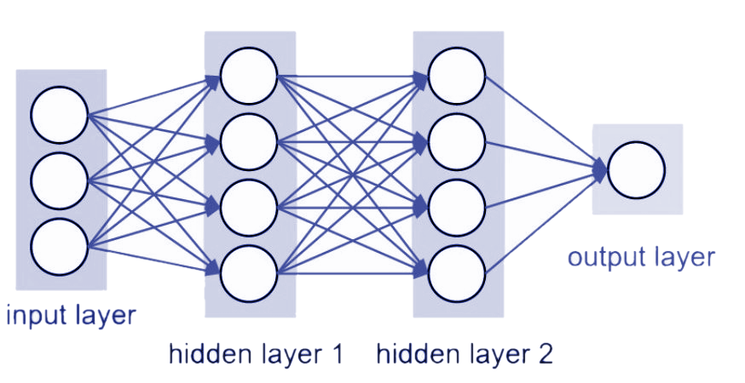
Sequential Model with Sigmoid Activation Function
Positive/Negative
Tweets.csv
Hidden Layer 1
Hidden Layer 2

Slide 6


Data Exploration

Slide 7
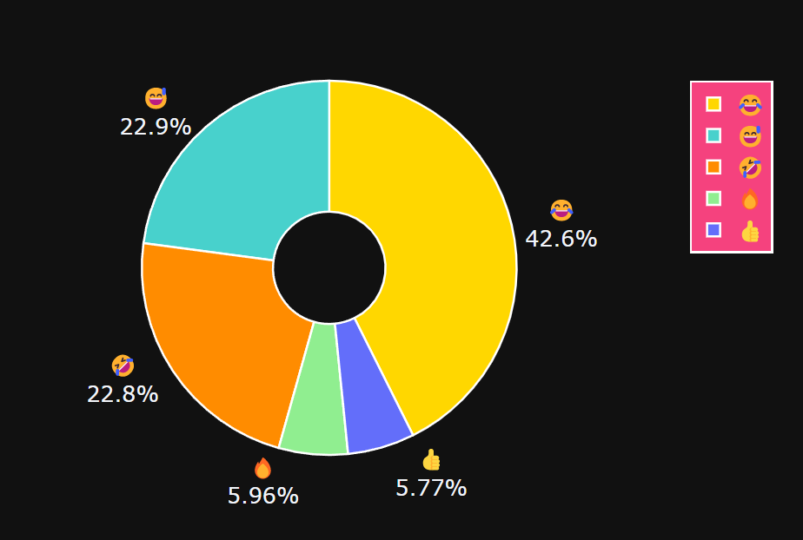
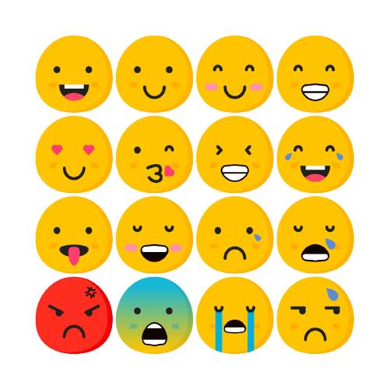
Emojis Distribution

Slide 8
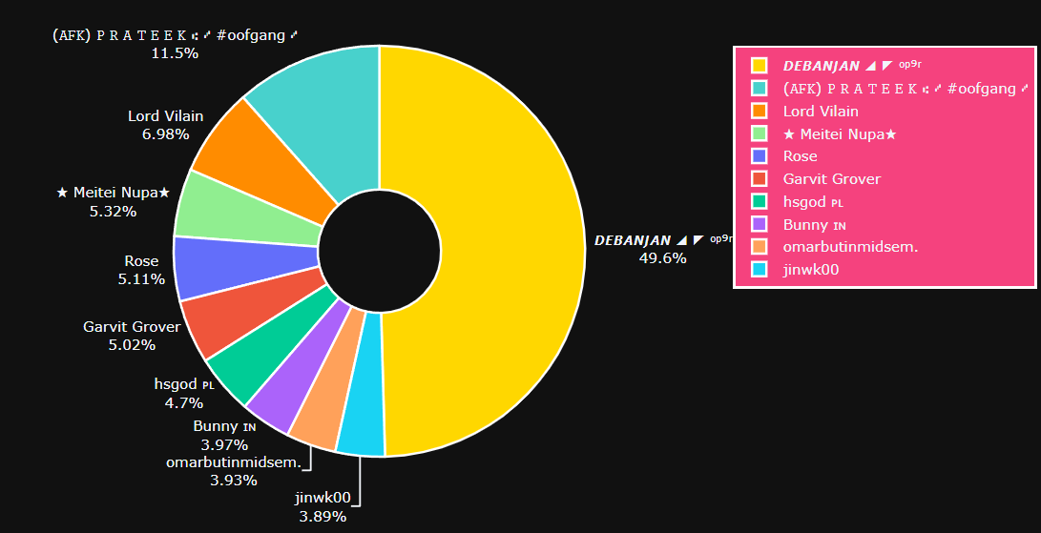
Most Active Users

Slide 9
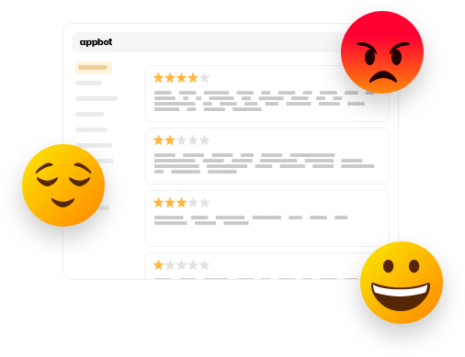

Sentiment Analysis

Slide 10
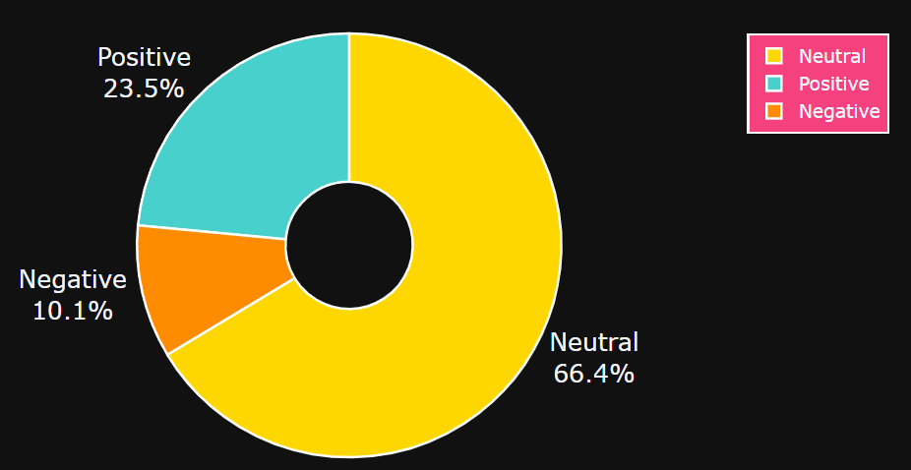
Vader Sentiment Analysis

Slide 11
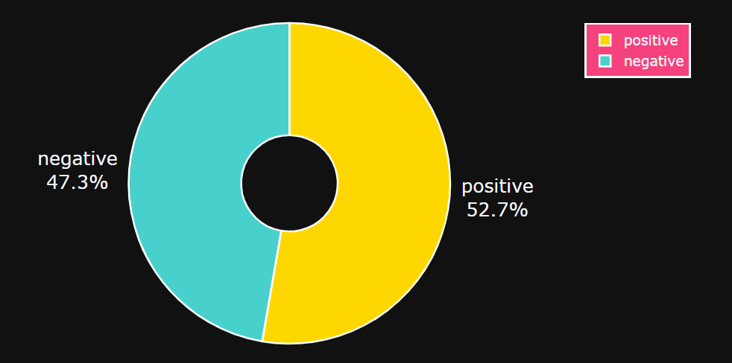
Deep Learning Based
Sentiment Analysis

Slide 12
References
https://sci-hub.hkvisa.net/https://ieeexplore.ieee.org/document/9388596
https://ieeexplore.ieee.org/document/7449182/
https://ieeexplore.ieee.org/document/9137911/
https://www.kaggle.com/mmuhammetcavus/whatsapp-chat
https://data.mendeley.com/datasets/wf5d5b2j52/1
https://github.com/dhfbk/WhatsApp-Dataset

Slide 13
Thank You

